Slide 1
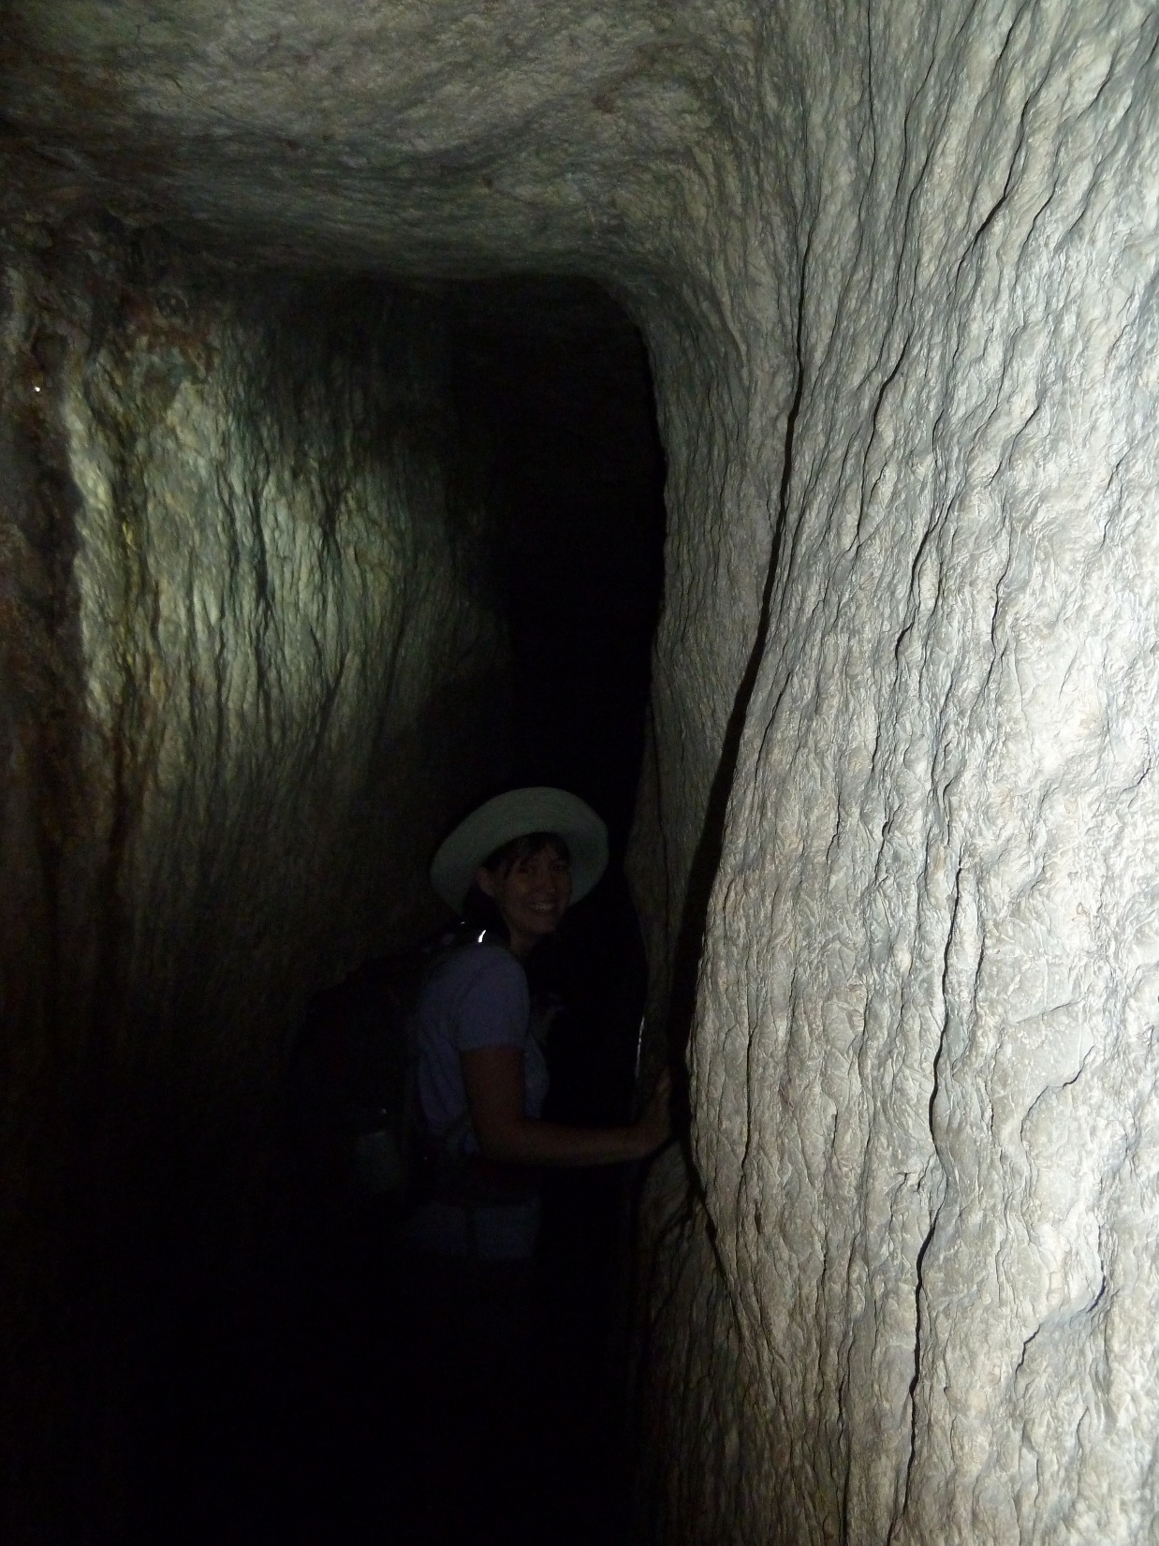
Do you believe enough to follow?
John 8.31-59

Slide 2
John 8.31-32 NET: Then Jesus said to those Judeans who had believed him, “If you continue to follow my teaching, you are really my disciples and you will know the truth, and the truth will set you free.”
“remain in my word”
true faith true willingness to follow

Slide 3
John 8.31-32 NET: Then Jesus said to those Judeans who had believed him, “If you continue to follow my teaching, you are really my disciples and you will know the truth, and the truth will set you free.”
“remain in my word”
true faith true willingness to follow
true disciples
follow Christ,
thus will know the truth
and the truth will lead to freedom
gospel redemption
scripture sanctification

Slide 4
John 8.33-34: “We are descendants of Abraham,” they replied, “and have never been anyone's slaves! How can you say, ‘You will become free’?” Jesus answered them, “I tell you the solemn truth, everyone who practices sin is a slave of sin.”
ἀμὴν ἀμὴν = truly truly

Slide 5
John 8.33-34: “We are descendants of Abraham,” they replied, “and have never been anyone's slaves! How can you say, ‘You will become free’?” Jesus answered them, “I tell you the solemn truth, everyone who practices sin is a slave of sin.”
ἀμὴν ἀμὴν = truly truly
practice of sin proves slavery to sin
and further enslaves us to sin

Slide 6
John 8.35-36: “The slave does not remain in the family forever, but the son remains forever. So if the son sets you free, you will be really free.”
Why is Jesus’
identity so important?

Slide 7
John 8.35-36: “The slave does not remain in the family forever, but the son remains forever. So if the son sets you free, you will be really free.”
Why is Jesus’
identity so important?
free to choose righteousness
free to choose to follow Jesus
free to choose the light

Slide 8
John 8.37-40: “I know that you are Abraham's descendants. But you want to kill me, because my teaching makes no progress among you. I am telling you the things I have seen while with the Father; as for you, practice the things you have heard from the Father!” They answered him, “Abraham is our father!” Jesus replied, “If you are Abraham's children, you would be doing the deeds of Abraham. But now you are trying to kill me, a man who has told you the truth I heard from God. Abraham did not do this!”

Slide 9
John 8.37: “I know that you are Abraham's descendants. But you want to kill me, because my teaching makes no progress among you.”
They respond favorably at first,
but Jesus’ teachings make no lasting impact on them.

Slide 10
John 8.38: “I am telling you the things I have seen while with the Father; as for you, practice the things you have heard from the Father!”
NET: a command to obey God
NIV: a description of obeying Satan

Slide 11
John 8.39-40: They answered him, “Abraham is our father!” Jesus replied, “If you are Abraham's children, you would be doing the deeds of Abraham. But now you are trying to kill me, a man who has told you the truth I heard from God. Abraham did not do this!”

Slide 12
John 8.41-43: “You people are doing the deeds of your father.” Then they said to Jesus, “We were not born as a result of immorality! We have only one Father, God himself.” Jesus replied, “If God were your Father, you would love me, for I have come from God and am now here. I have not come on my own initiative, but he sent me. Why don't you understand what I am saying? It is because you cannot accept my teaching.”
“you are not able to hear my word”
= they will not accept it, will not honor and obey it

Slide 13
John 8.44: “You people are from your father the devil, and you want to do what your father desires. He was a murderer from the beginning, and does not uphold the truth, because there is no truth in him. Whenever he lies, he speaks according to his own nature, because he is a liar and the father of lies.

Slide 14
John 8.44: “You people are from your father the devil, and you want to do what your father desires. He was a murderer from the beginning, and does not uphold the truth, because there is no truth in him. Whenever he lies, he speaks according to his own nature, because he is a liar and the father of lies.
Satan…
introduced death into the world
has caused the death of some people
lied in the first temptation
promotes deception

Slide 15
John 8.45-47: “But because I am telling you the truth, you do not believe me. Who among you can prove me guilty of any sin? If I am telling you the truth, why don't you believe me? The one who belongs to God listens and responds to God's words. You don't listen and respond, because you don't belong to God.”

Slide 16
John 8.48-51: The Judeans replied, “Aren't we correct in saying that you are a Samaritan and are possessed by a demon?” Jesus answered, “I am not possessed by a demon, but I honor my Father– and yet you dishonor me. I am not trying to get praise for myself. There is one who demands it, and he also judges.
I tell you the solemn truth, if anyone obeys my teaching, he will never see death.”
ἀμὴν ἀμὴν = truly truly always have
spiritual life

Slide 17
John 8.51: “I tell you the solemn truth,
if anyone obeys my teaching,
he will never see death.”
ἀμὴν ἀμὴν = truly truly
always have spiritual life
now and in eternity

Slide 18
John 8.51: “I tell you the solemn truth,
if anyone obeys my teaching, he will never see death.”
“if anyone should keep my word.”
τηρέω = I keep / I guard

Slide 19
John 8.52-56: Then the Judeans responded, “Now we know you're possessed by a demon! Both Abraham and the prophets died, and yet you say, ‘If anyone obeys my teaching, he will never experience death.’ You aren't greater than our father Abraham who died, are you? And the prophets died too! Who do you claim to be?” Jesus replied, "If I glorify myself, my glory is worthless. The one who glorifies me is my Father, about whom you people say, ‘He is our God.’ Yet you do not know him, but I know him. If I were to say that I do not know him, I would be a liar like you. But I do know him, and I obey his teaching. Your father Abraham was overjoyed to see my day, and he saw it and was glad.”

Slide 20
John 8.57-59: Then the Judeans replied, “You are not yet fifty years old! Have you seen Abraham?” Jesus said to them, “I tell you the solemn truth, before Abraham came into existence, I am!”
Then they picked up stones to
throw at him, but Jesus hid ἐγώ εἰμι
himself and went out from
the temple area.

Slide 21
If you truly believe in Jesus as your savior,
then you will seek to obey and follow him,
so you will know the truth that will set you free.
go to Heaven
Faith never taste death walk in light
Obedience
Knowledge
Freedom

